Slide 1
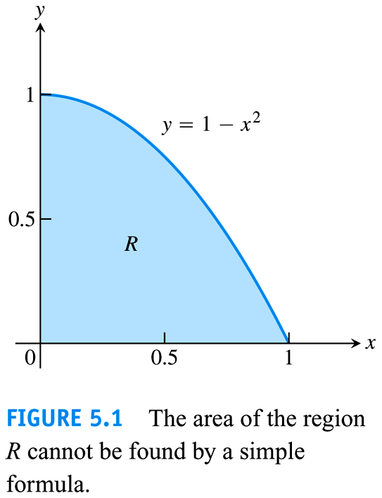
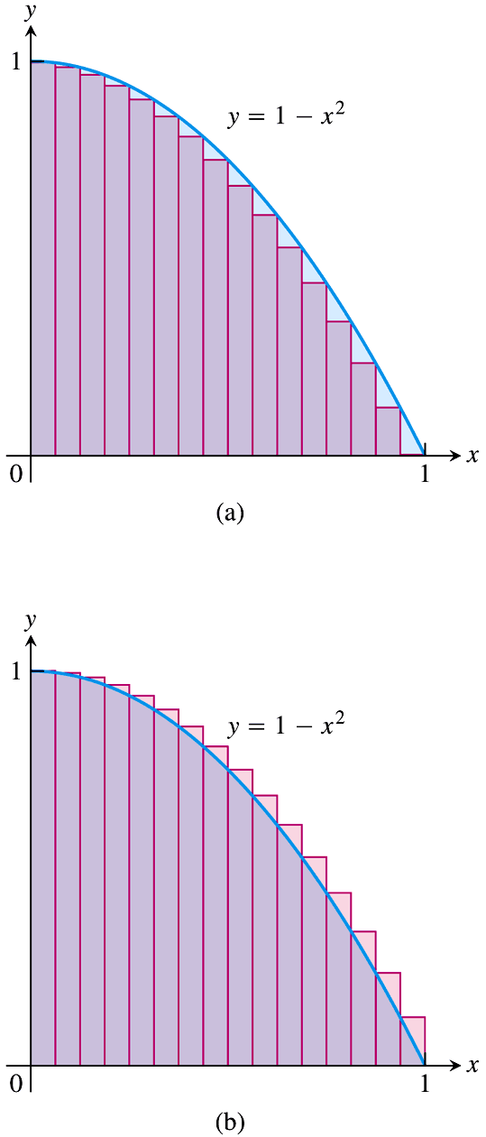
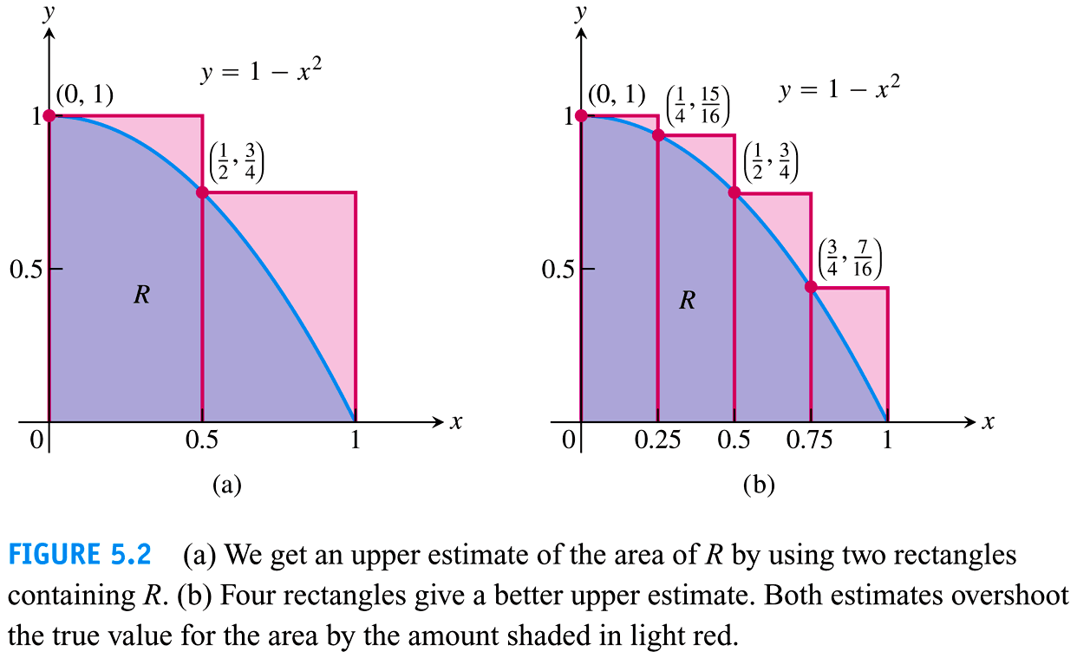
Section 5.3 – The Definite Integral
As the number of rectangles increased, the approximation of the area under the curve approaches a value.
Copyright © 2010 Pearson Education, Inc.

Slide 2
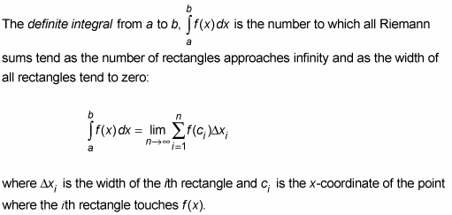
Section 5.3 – The Definite Integral
Definition
Note: The function f(x) must be continuous on the interval [a, b].

Slide 3
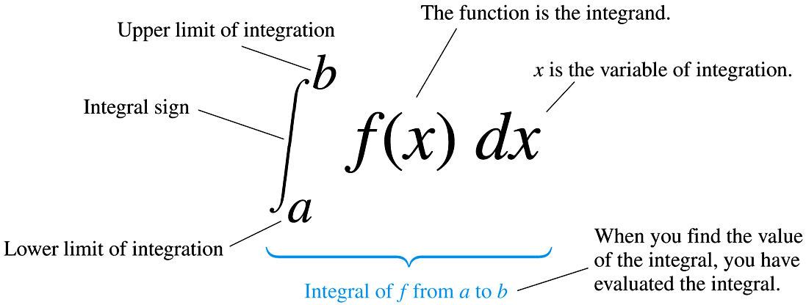
Section 5.3 – The Definite Integral
Parts of the Definite Integral
Copyright © 2010 Pearson Education, Inc.

Slide 4
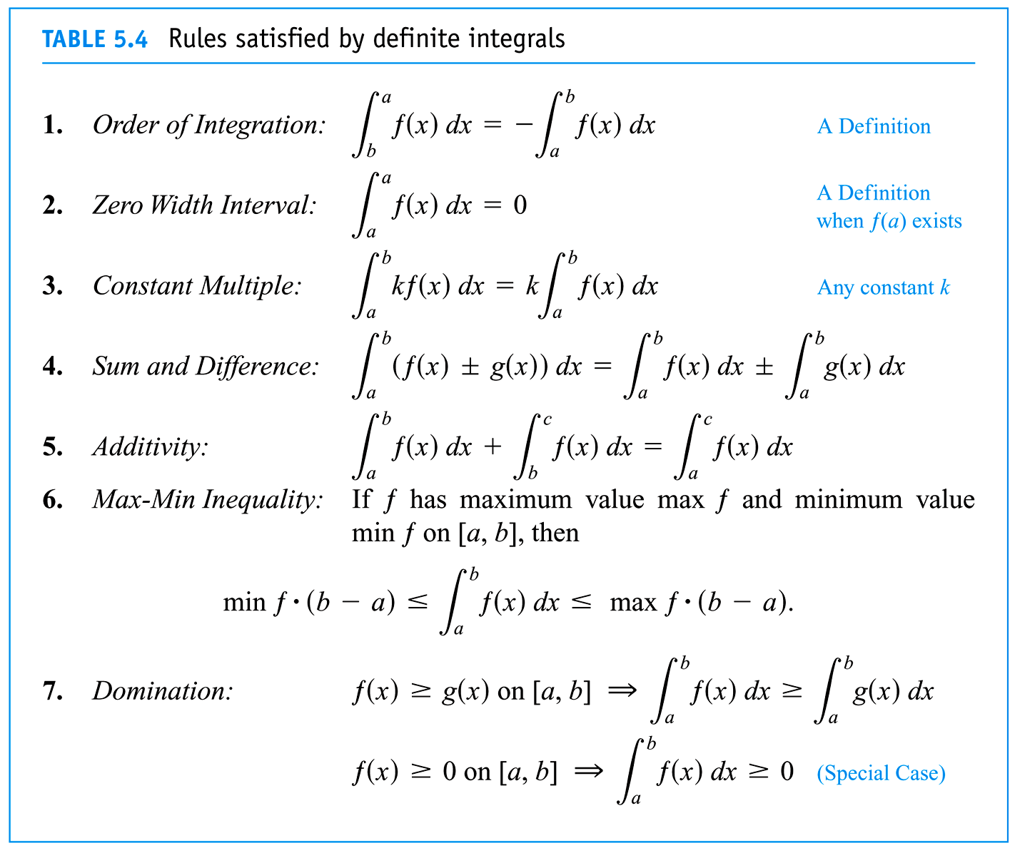
Section 5.3 – The Definite Integral
Properties of the Definite Integral
Copyright © 2010 Pearson Education, Inc.

Slide 5
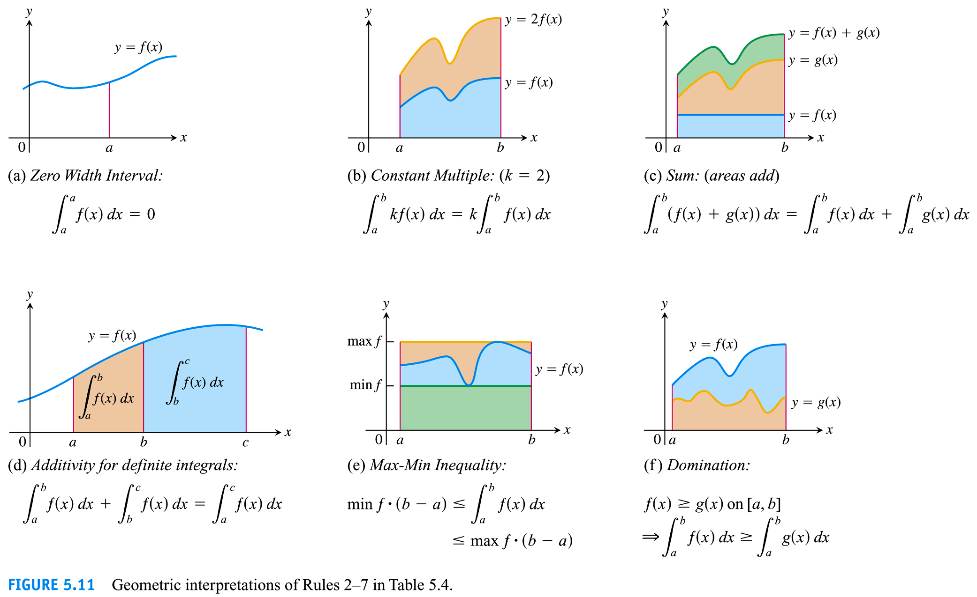
Section 5.3 – The Definite Integral
Geometric Interpretations of the Properties of the Definite Integral
Copyright © 2010 Pearson Education, Inc.

Slide 6
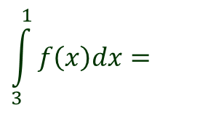
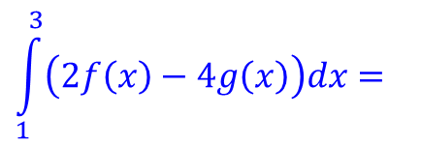
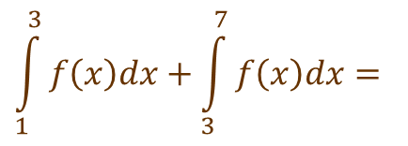
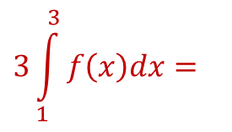
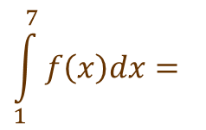
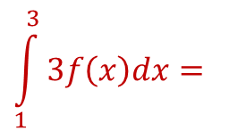
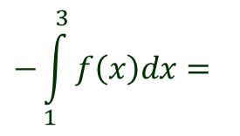
Section 5.3 – The Definite Integral
Using the Properties of the Definite Integral
$$\int_{1}^{3}{f\left(x\right)dx}=6 \int_{3}^{7}{f\left(x\right)dx}=9 \int_{1}^{3}{g\left(x\right)dx}=−4$$
Given:
$$\int_{1}^{3}{3f\left(x\right)dx}=$$
$$3\int_{1}^{3}{f\left(x\right)dx}=$$
$$3\left(6\right)=18$$
$$\int_{1}^{3}{\left(2f\left(x\right)−4g\left(x\right)\right)dx}=$$
$$2\int_{1}^{3}{f\left(x\right)dx}−4\int_{1}^{3}{g\left(x\right)dx}=$$
$$2\left(6\right)−4\left(−4\right)=28$$
$$\int_{1}^{7}{f\left(x\right)dx}=$$
$$\int_{1}^{3}{f\left(x\right)dx}+\int_{3}^{7}{f\left(x\right)dx}=$$
$$6+9=15$$
$$\int_{3}^{1}{f\left(x\right)dx}=$$
$$−\int_{1}^{3}{f\left(x\right)dx}=$$
$$−6$$

Slide 7
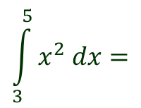
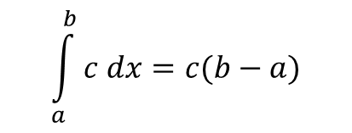
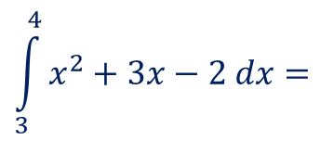
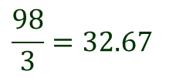
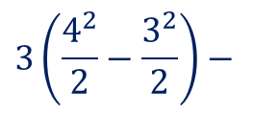
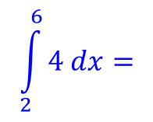
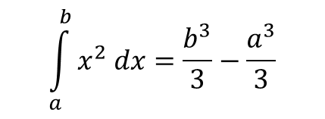
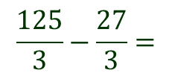
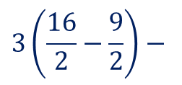
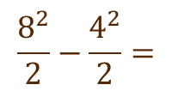
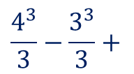
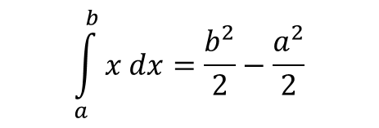
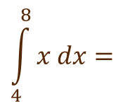
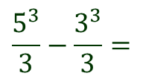
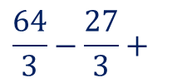
Section 5.3 – The Definite Integral
Rules of the Definite Integral
$$\int_{a}^{b}{c dx=c(b−a)}$$
$$\int_{a}^{b}{x dx=\frac{b^{2}}{2}−\frac{a^{2}}{2}}$$
$$\int_{a}^{b}{x^{2} dx=\frac{b^{3}}{3}−\frac{a^{3}}{3}}$$
Examples
$$\int_{2}^{6}{4 dx=}$$
$$\int_{4}^{8}{x dx=}$$
$$\frac{8^{2}}{2}−\frac{4^{2}}{2}=$$
$$4\left(6−2\right)=$$
$$16$$
$$32−8=$$
$$24$$
$$\int_{3}^{5}{x^{2} dx}=$$
$$\frac{5^{3}}{3}−\frac{3^{3}}{3}=$$
$$\frac{125}{3}−\frac{27}{3}=$$
$$\frac{98}{3}=32.67$$
$$\int_{3}^{4}{x^{2}+3x−2 dx}=$$
$$\int_{3}^{4}{x^{2} dx}+3\int_{3}^{4}{x dx}−\int_{3}^{4}{2 dx}=$$
$$\frac{4^{3}}{3}−\frac{3^{3}}{3}+$$
$$3\left(\frac{4^{2}}{2}−\frac{3^{2}}{2}\right)−$$
$$2\left(4−3\right)=$$
$$\frac{64}{3}−\frac{27}{3}+$$
$$3\left(\frac{16}{2}−\frac{9}{2}\right)−$$
$$2\left(1\right)=$$
$$20.83$$

Slide 8
Section 5.4 – The Fundamental Theorem of Calculus
The Fundamental Theorem of Calculus
$$If f is continuous at every point in \left[a, b\right] and F is any$$
$$antiderivative of f on \left[a, b\right], then$$
$$\int_{a}^{b}{f\left(x\right)dx=F\left(b\right)−F(a)}.$$
Examples
$$\int_{1}^{5}{5x dx}=$$
5
$$\frac{5x^{2}}{2} =$$
$$\frac{{5(5)}^{2}}{2}$$
$$−\frac{{5\left(1\right)}^{2}}{2}=$$
$$\frac{125}{2}−\frac{5}{2}=$$
$$\frac{120}{2}=60$$
1
$$\int_{π/6}^{{2π}/3}{sinx dx}=$$
$$−cos\left(\frac{2π}{3}\right)$$
$$−\left(−cos\left(\frac{π}{6}\right)\right)=$$
$$−\left(−\frac{1}{2}\right)−\left(−\frac{\sqrt{3}}{2}\right)=$$
$$−cosx =$$
$$0.866$$
$$π/6$$

Slide 9
Section 5.4 – The Fundamental Theorem of Calculus
The Fundamental Theorem of Calculus
$$\int_{a}^{b}{f\left(x\right)dx=F\left(b\right)−F(a)}.$$
Examples
$$\int_{3}^{4}{x^{2}+3x−2 dx}=$$
4
$$\frac{x^{3}}{3}+\frac{3x^{2}}{2}−2x =$$
$$\frac{4^{3}}{3}+\frac{3{(4)}^{2}}{2}−2(4)$$
$$−\left(\frac{3^{3}}{3}+\frac{3{(3)}^{2}}{2}−2(3) \right)$$
3
$$37.33−16.5=$$
$$20.83$$
$$\int_{1}^{32}{\frac{1}{x^{6/5}} dx}=$$
$$\int_{1}^{32}{x^{{−6}/5} dx}=$$
32
32
$$\frac{x^{{−1}/5}}{−\frac{1}{5}} =$$
$$\frac{−5}{x^{1/5}} =$$
$$−\frac{5}{2}−\left(−\frac{5}{1}\right)=$$
$$2.5$$
1
1

Slide 10
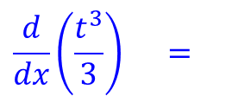
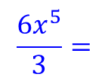
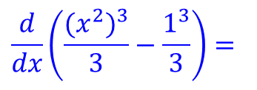
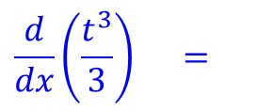
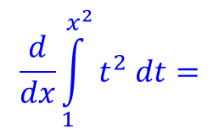
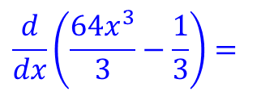
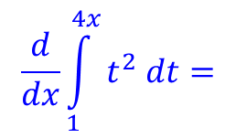
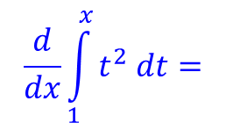
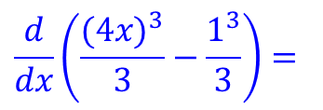
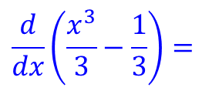
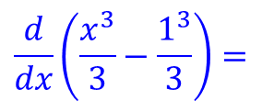
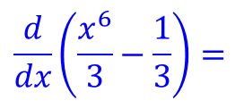
Section 5.4 – The Fundamental Theorem of Calculus
Differentiating a Definite Integral
$$If f is continuous on \left[a, b\right] and x is any point on \left[a, b\right], then$$
$$F^{′}\left(x\right)=\frac{d}{dx}\int_{a}^{x}{f\left(t\right)dt=f(x)}$$
$$\frac{d}{dx}\int_{1}^{x}{t^{2} dt=}$$
$$x$$
$$\frac{d}{dx}\left(\frac{t^{3}}{3}\right) =$$
$$\frac{d}{dx}\left(\frac{x^{3}}{3}−\frac{1^{3}}{3}\right)=$$
$$\frac{d}{dx}\left(\frac{x^{3}}{3}−\frac{1}{3}\right)=$$
$$x^{2}$$
1
$$\frac{d}{dx}\int_{1}^{4x}{t^{2} dt=}$$
$$4x$$
$$\frac{d}{dx}\left(\frac{t^{3}}{3}\right) =$$
$$\frac{d}{dx}\left(\frac{{(4x)}^{3}}{3}−\frac{1^{3}}{3}\right)=$$
$$\frac{d}{dx}\left(\frac{{64x}^{3}}{3}−\frac{1}{3}\right)=$$
$${64x}^{2}$$
1
$$\frac{d}{dx}\int_{1}^{x^{2}}{t^{2} dt=}$$
$$x^{2}$$
$$\frac{d}{dx}\left(\frac{t^{3}}{3}\right) =$$
$$\frac{d}{dx}\left(\frac{{(x^{2})}^{3}}{3}−\frac{1^{3}}{3}\right)=$$
$$\frac{d}{dx}\left(\frac{x^{6}}{3}−\frac{1}{3}\right)=$$
$$\frac{6x^{5}}{3}=$$
$${2x}^{5}$$
1

Slide 11
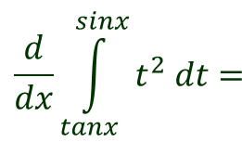
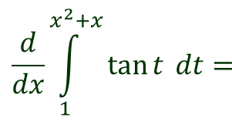
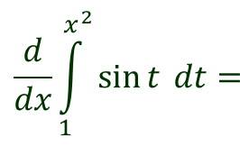
Section 5.4 – The Fundamental Theorem of Calculus
Differentiating a Definite Integral
$$If f is continuous on \left[a, b\right] and x is any point on \left[a, b\right], then$$
$$F^{′}\left(x\right)=\frac{d}{dx}\int_{a}^{x}{f\left(t\right)dt=f(x)}$$
$$\frac{d}{dx}\int_{1}^{x}{t^{2} dt=}$$
$$\frac{d}{dx}\int_{1}^{x^{2}}{\sin{t} dt=}$$
$${\left(x\right)}^{2}\left(1\right)=$$
$$x^{2}$$
$$\left(2x\right)sin\left(x^{2}\right)$$
$$\frac{d}{dx}\int_{1}^{4x}{t^{2} dt=}$$
$$\frac{d}{dx}\int_{1}^{x^{2}+x}{\tan{t} dt=}$$
$${\left(4x\right)}^{2}\left(4\right)=$$
$${64x}^{2}$$
$$\left(2x+1\right)tan\left(x^{2}+2\right)$$
$$\frac{d}{dx}\int_{1}^{x^{2}}{t^{2} dt=}$$
$$\frac{d}{dx}\int_{tanx}^{sinx}{t^{2} dt=}$$
$${\left(x^{2}\right)}^{2}\left(2x\right)=$$
$${2x}^{5}$$
$${(sin}^{2}x)\left(cosx\right)$$
$${−(tan}^{2}x)\left(\sec^{2}x\right)$$

Slide 12
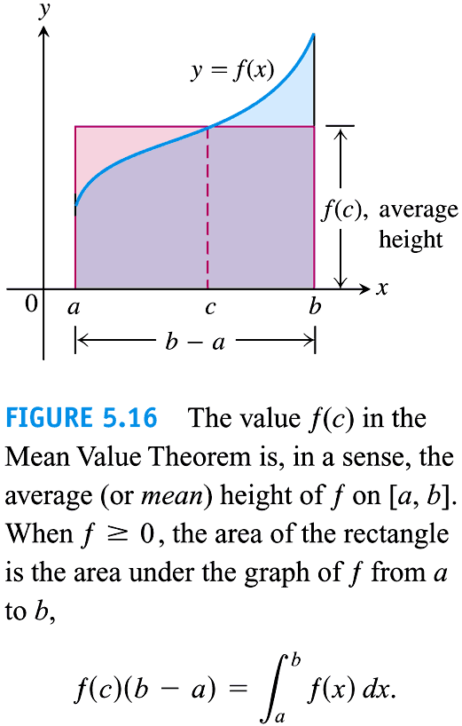
Section 5.4 – The Fundamental Theorem of Calculus
Mean Value Theorem for Integrals
Copyright © 2010 Pearson Education, Inc.

Slide 13
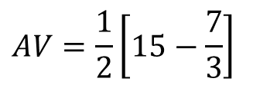
Section 5.3 – The Definite Integral
Mean Value for Definite Integral
Find the mean (average) value of the function $f\left(x\right)=x^{2}+2$ over the interval $\left[1, 3\right]$
$$AV=\frac{1}{3−1}\int_{1}^{3}{\left(x^{2}+2 \right) dx}$$
$$3$$
$$AV=\frac{1}{2}\left(\frac{x^{3}}{3}+2x\right)$$
1
$$AV=\frac{1}{2}\left[\left(\frac{27}{3}+6\right)−\left(\frac{1}{3}+2\right)\right]$$
$$AV=\frac{1}{2}\left[15−\frac{7}{3}\right]$$
$$AV=\frac{19}{3}=6.33$$

Slide 14
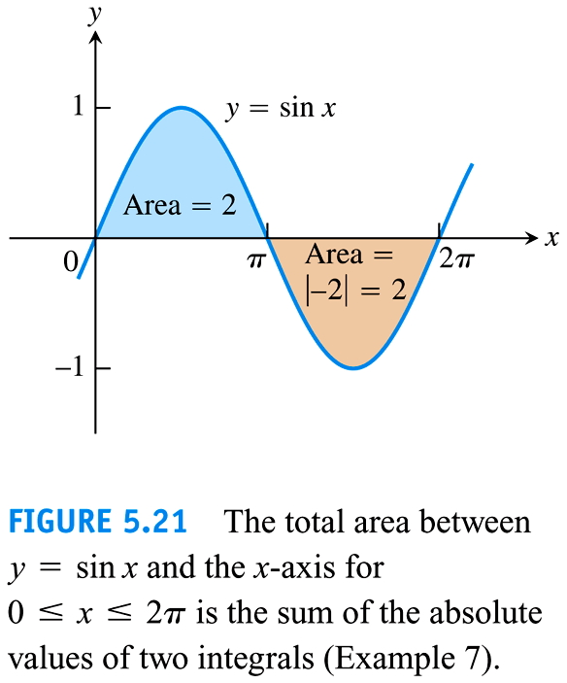

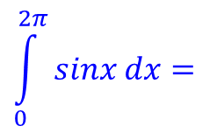
Section 5.3 – The Definite Integral
Difference between the Value of a Definite Integral and Total Area
Find the mean (average) value of the function $f\left(x\right)=sinx$ over the interval $\left[0, 2π\right]$
Total Area
$$\int_{0}^{2π}{sinx dx}=$$
$$\int_{0}^{π}{sinx dx}−\int_{π}^{2π}{sinx dx}=$$
$$π$$
$$2π$$
Value of the Definite Integral
$$−cosx −$$
$$−cosx$$
$$\int_{0}^{2π}{sinx dx}=$$
$$2π$$
0
$$π$$
$$−cosx =$$
$$−cos\left(π\right)$$
$$−\left(−cos\left(0\right)\right)−$$
$$\left[\left(−cos\left(2π\right)−\left(−cos\left(π\right)\right)\right)\right]$$
0
$$−cos\left(2π\right)$$
$$−\left(−cos\left(0\right)\right)=$$
$$−\left(−1\right)−\left(−1\right)−$$
$$\left(−\left(1\right)−\left(1\right)\right)=$$
$$4$$
$$−\left(1\right)−\left(−1\right)=$$
$$0$$
Copyright © 2010 Pearson Education, Inc.

