Slide 1
4.1 – Extreme Values of Functions
Extreme Values of a function are created when the function changes from increasing to decreasing or from decreasing to increasing
Extreme value
•
increasing
decreasing
decreasing
increasing
•
Extreme value
Extreme value
Extreme value
Extreme value
dec
inc
inc
dec
inc
dec
dec
Extreme value
Extreme value

Slide 2
4.1 – Extreme Values of Functions
Classifications of Extreme Values
Absolute Minimum – the smallest function value in the domain
Absolute Maximum – the largest function value in the domain
Local Minimum – the smallest function value in an open interval in the domain
Local Maximum – the largest function value in an open interval in the domain
Absolute Maximum
Local Maximum
Local Minimum
Absolute Minimum
Absolute Minimum
Local Maximum
Absolute Maximum
Local Maximum
Local Maximum
Local Maximum
Local Minimum
Local Minimum
Local Minimum
Local Minimum

Slide 3
4.1 – Extreme Values of Functions
Definitions:
Absolute Minimum – occurs at a point c if $f(c)≤f(x)$ for x all values in the domain.
c
Absolute Minimum at c
Absolute Maximum – occurs at a point c if $f\left(c\right)≥f(x)$ for all x values in the domain.
c
Absolute Maximum at c
Local Minimum – occurs at a point c in an open interval, $(a,b)$, in the domain if $f(c)≤f(x)$ for all x values in the open interval.
a
c
b
Local Minimum at c
Local Maximum – occurs at a point c in an open interval, $(a,b)$, in the domain if $f(c)≥f(x)$ for all x values in the open interval.
a
c
b
Local Maximum at c

Slide 4
4.1 – Extreme Values of Functions
The Extreme Value Theorem (Max-Min Existence Theorem)
If a function is continuous on a closed interval, [a, b], then the function will contain both an absolute maximum value and an absolute minimum value.
$$f(a)$$
$$f(b)$$
$$f(c)$$
a
c
b
Absolute maximum value: f(a)
Absolute minimum value: f(c)

Slide 5
4.1 – Extreme Values of Functions
The Extreme Value Theorem (Max-Min Existence Theorem)
If a function is continuous on a closed interval, [a, b], then the function will contain both an absolute maximum value and an absolute minimum value.
$$f(c)$$
$$f(b)$$
$$f(a)$$
$$f(d)$$
a
c
d
b
Absolute maximum value: f(c)
Absolute minimum value: f(d)

Slide 6
4.1 – Extreme Values of Functions
The Extreme Value Theorem (Max-Min Existence Theorem)
If a function is continuous on a closed interval, [a, b], then the function will contain both an absolute maximum value and an absolute minimum value.
$$f\left(c\right): DNE$$
F is not continuous at c.
$$f(b)$$
Theorem does not apply.
$$f(a)$$
$$f(d)$$
a
c
d
b
Absolute maximum value: none
Absolute minimum value: f(d)

Slide 7
4.1 – Extreme Values of Functions
The Extreme Value Theorem (Max-Min Existence Theorem)
If a function is continuous on a closed interval, [a, b], then the function will contain both an absolute maximum value and an absolute minimum value.
$$f\left(c\right)$$
•
F is not continuous at c.
$$f(b)$$
Theorem does not apply.
$$f(a)$$
$$f(d)$$
a
c
d
b
Absolute maximum value: f(c)
Absolute minimum value: f(d)

Slide 8
4.1 – Extreme Values of Functions
The First Derivative Theorem for Local Extreme Values
If a function has a local maximum or minimum value at a point (c) in the domain and the derivative is defined at that point, then $f′\left(c\right)=0$.
Slope of the tangent line at c is zero.
$$f′\left(c\right)>0$$
$$f′\left(c\right)<0$$
$$f′\left(c\right)=0$$
c
$$f′\left(c\right)<0$$
$$f′\left(c\right)>0$$
c

Slide 9
4.1 – Extreme Values of Functions
Critical Points
If a function has an extreme value, then the value of the domain at which it occurs is defined as a critical point.
Three Types of Critical Points
$$\left(1\right) Endpoints of an interval$$
$$\left(2\right) Stationary Points: f′\left(c\right)=0$$
$$\left(3\right) Singular Points: f′\left(c\right) does not exist$$
$$(1)$$
$$(2)$$
$$(2)$$
$$(3)$$
$$(2)$$
$$(2)$$
$$(1)$$

Slide 10
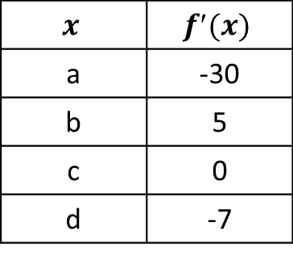
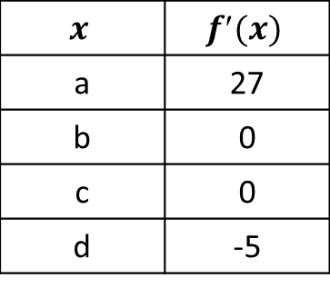
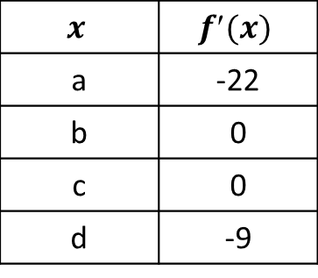
4.1 – Extreme Values of Functions
Which table best describes the graph?
a b c d
Table A
Table B
Table C
$$x$$ | $$f(x)$$
a | 27
b | 0
c | 0
d | -5
$$x$$ | $$f(x)$$
a | -30
b | 5
c | 0
d | -7
$$x$$ | $$f(x)$$
a | -22
b | 0
c | 0
d | -9

Slide 11
4.1 – Extreme Values of Functions
Graph the function. State the location(s) of any absolute extreme values, if applicable. Does the Extreme Value Theorem apply?
$$f\left(x\right)=\left\{\begin{matrix}\frac{1}{x} & if −1≤x<0 \\ \sqrt{x} & if 0≤x≤4\end{matrix}\right.$$
-1 4
No absolute minimum
Absolute maximum at x = 4
The Extreme Value Theorem does not apply
The function is not continuous at x = 0.

Slide 12
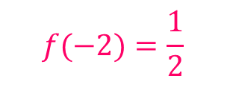
4.1 – Extreme Values of Functions
Graph the function. Calculate any absolute extreme values, if applicable. Plot them on the graph and state the coordinates.
$$f\left(x\right)=−\frac{1}{x} −2≤x≤−1$$
$$f\left(x\right)=−x^{−1}$$
$$f′\left(x\right)=x^{−2}=\frac{1}{x^{2}}$$
$$(−1, 1)$$
$$f′\left(x\right)≠0$$
$$(−2, \frac{1}{2})$$
$$f′\left(x\right) is undefined at x=0$$
-2 -1
$$x=0 is not a critical point;$$
$$not in [−2,−1]$$
Critical points
$$x=−2, −1$$
$$f(−2)=\frac{1}{2}$$
Absolute minimum
$$f(−1)=1$$
Absolute maximum

Slide 13
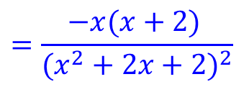
4.1 – Extreme Values of Functions
Calculate any absolute extreme values. State their identities and coordinates.
$$f\left(x\right)=\frac{x+1}{x^{2}+2x+2}$$
$$f′\left(x\right)=\frac{{(x}^{2}+2x+2)\left(1\right)−(x+1)(2x+2)}{{(x^{2}+2x+2)}^{2}}$$
$$f′\left(x\right)=\frac{{−x}^{2}−2x }{{(x^{2}+2x+2)}^{2}}$$
$$=\frac{−x(x+2) }{{(x^{2}+2x+2)}^{2}}$$
Critical points
$$f\left(−2\right)=−0.5$$
Absolute minimum
$$f′\left(x\right)=0$$
$$(−2, −0.5)$$
$$x=−2, 0$$
$$Is f′\left(x\right) undefined?$$
$$f\left(0\right)=0.5$$
Absolute maximum
$$x^{2}+2x+2=0$$
$$(0, 0.5)$$
$$x=\frac{−2±\sqrt{2^{2}−4(1)(2)} }{2(1)}$$
$$no real solutions$$

Slide 14
4.2 – The Mean Value Theorem
Rolle’s Theorem
A function is given that is continuous on every point of a closed interval,[a, b], and it is differentiable on every point of the open interval (a, b). If $f\left(a\right)=f(b)$, then there exists at least one value in the open interval,(a, b), where $f′\left(c\right)=0$.
$$f′\left( c\right)=0$$
$${slope}_{segment ab}=\frac{f\left(b\right)−f(a)}{b−a}=\frac{0}{b−a}=0$$
$$f\left(a\right)=f(b)$$
$${slope}_{tangent @ c}=0$$
a
c
b
$$f′\left( c\right)=0$$

Slide 15
4.2 – The Mean Value Theorem
Rolle’s Theorem
A function is given that is continuous on every point of a closed interval,[a, b], and it is differentiable on every point of the open interval (a, b). If $f\left(a\right)=f(b)$, then there exists at least one value in the open interval,(a, b), where $f′\left(c\right)=0$.
$$f′\left( c\right)=0$$
$${slope}_{segment ab}=\frac{f\left(b\right)−f(a)}{b−a}=\frac{0}{b−a}=0$$
$$f\left(a\right)=f(b)$$
$$f′\left( d\right)=0$$
$${slope}_{tangent @ c}=0$$
$${slope}_{tangent @ d}=0$$
a
c
d
b
$$f′\left( c\right)=0$$
$$f′\left( d\right)=0$$

Slide 16
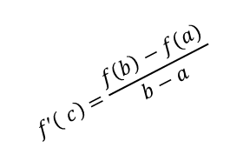
4.2 – The Mean Value Theorem
The Mean Value Theorem
A function is given that is continuous on every point of a closed interval,[a, b], and it is differentiable on every point of the open interval (a, b). If $f\left(a\right)=f(b)$, then there exists at least one value (c) in the open interval,(a, b), where
$\frac{f\left(b\right)−f(a)}{b−a}=f′\left(c\right)$.
$$f′\left( c\right)=\frac{f\left(b\right)−f(a)}{b−a}$$
$${slope}_{segment ab}=\frac{f\left(b\right)−f(a)}{b−a}$$
$$f(b)$$
$${slope}_{tangent @ c}=f(c)$$
$$f\left(a\right)$$
$$f′\left( c\right)=\frac{f\left(b\right)−f(a)}{b−a}$$
a
c
b

Slide 17
4.2 – The Mean Value Theorem
The Mean Value Theorem
A function is given that is continuous on every point of a closed interval,[a, b], and it is differentiable on every point of the open interval (a, b). If $f\left(a\right)=f(b)$, then there exists at least one value (c) in the open interval,(a, b), where
$\frac{f\left(b\right)−f(a)}{b−a}=f′\left(c\right)$.
$${slope}_{segment ab}=\frac{f\left(b\right)−f(a)}{b−a}$$
$$f(a)$$
$${slope}_{tangent @ c}=f(c)$$
$$f(b)$$
$$f′\left( c\right)=\frac{f\left(b\right)−f(a)}{b−a}$$
a
c
d
b
$${slope}_{tangent @ d}=f(d)$$
$$f′\left( d\right)=\frac{f\left(b\right)−f(a)}{b−a}$$

Slide 18
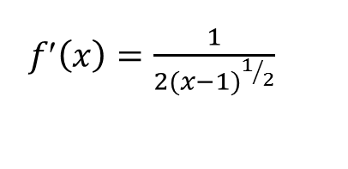
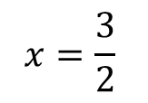
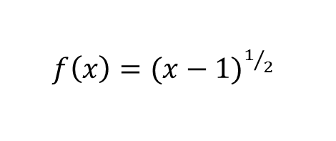
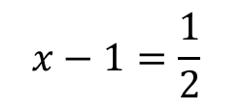

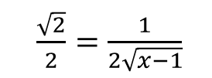
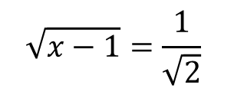
4.2 – The Mean Value Theorem
Find the values of x that satisfy the Mean Value Theorem:
$f\left(x\right)=\sqrt{x−1} [1, 3]$
$\frac{f\left(b\right)−f(a)}{b−a}=f′\left(x\right)$
${slope }_{secant line}=\frac{f\left(3\right)−f(1)}{3−1}$
${slope }_{secant line}=\frac{\sqrt{2}}{2}$
$f\left(x\right)={(x−1)}^{1/2}$
$f′\left(x\right)=\frac{1}{2}{\left(x−1\right)}^{−1/2}(1)$
$f′\left(x\right)=\frac{1}{2{(x−1)}^{1/2}}$
$=\frac{1}{2\sqrt{x−1}}$
$\frac{\sqrt{2}}{2}=\frac{1}{2\sqrt{x−1}}$
$$
$$\sqrt{2}2\sqrt{x−1}=2$$
$$\sqrt{x−1}=\frac{1}{\sqrt{2}}$$
$$\sqrt{2}\sqrt{x−1}=1$$
$$
$$x−1=\frac{1}{2}$$
$$x=\frac{3}{2}$$
$$

